Slide 1


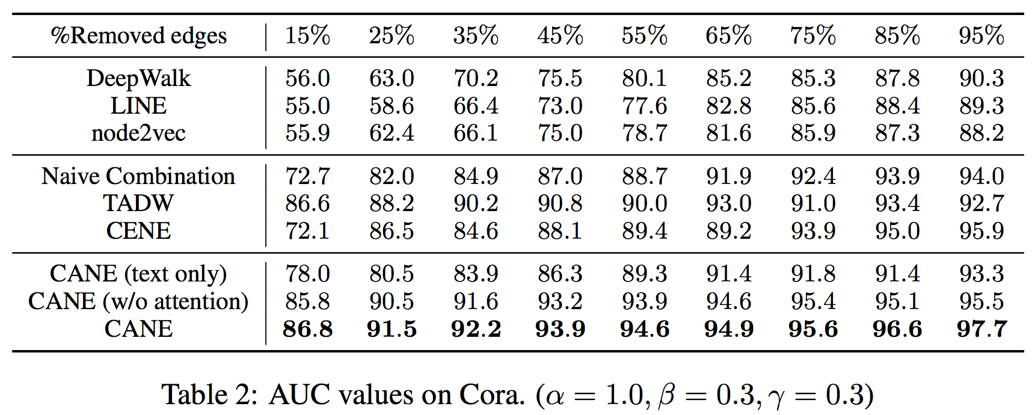
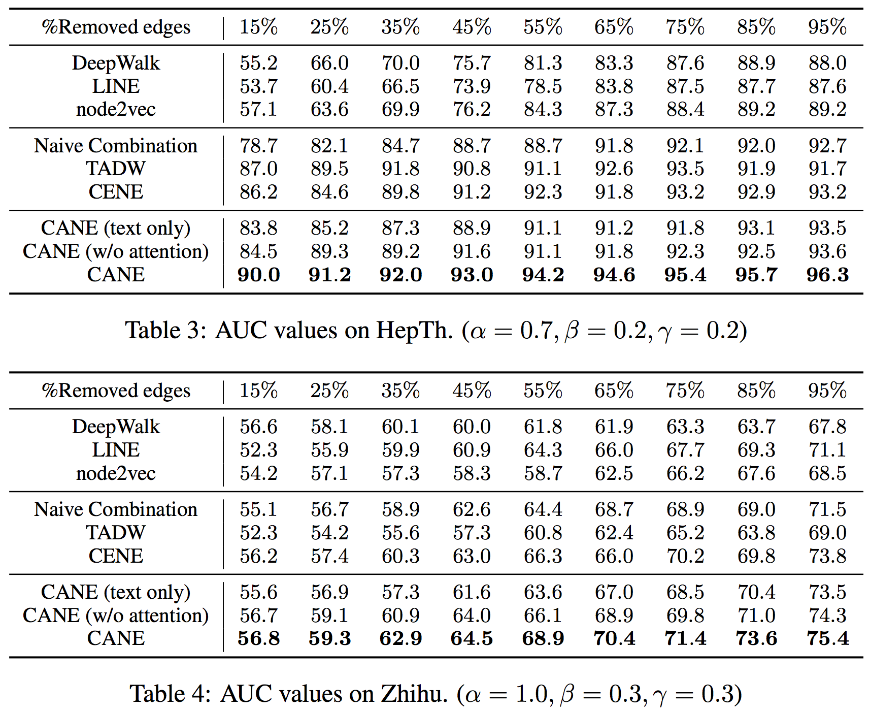
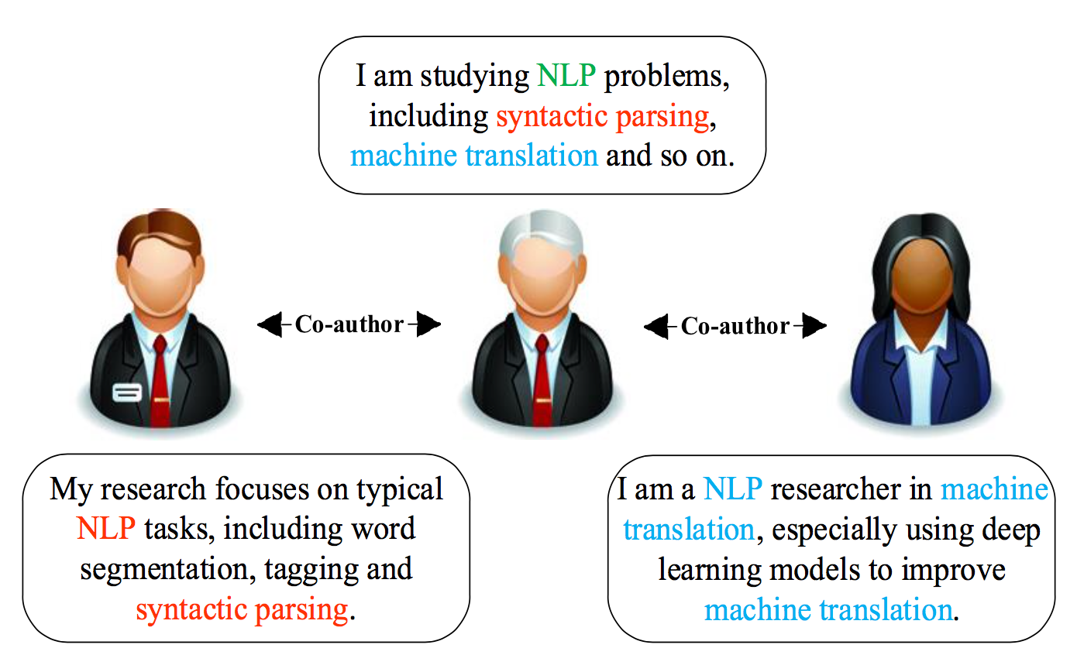
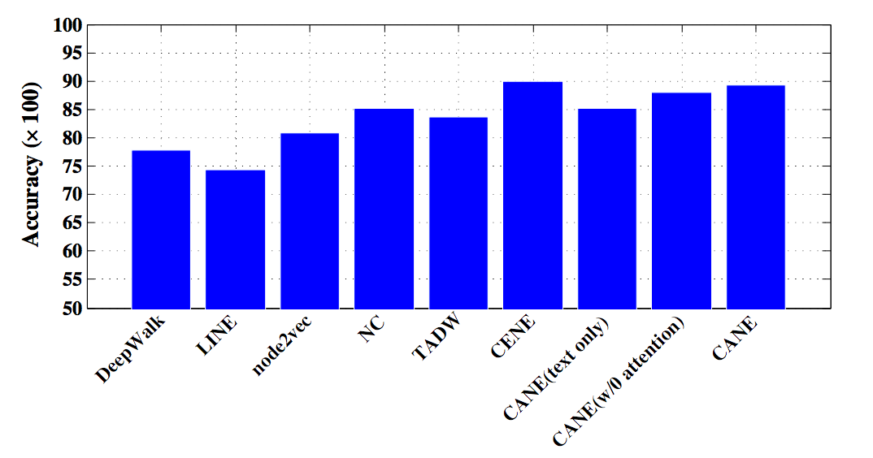
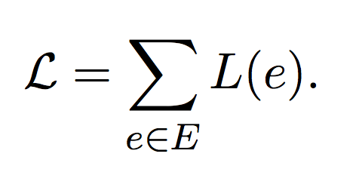
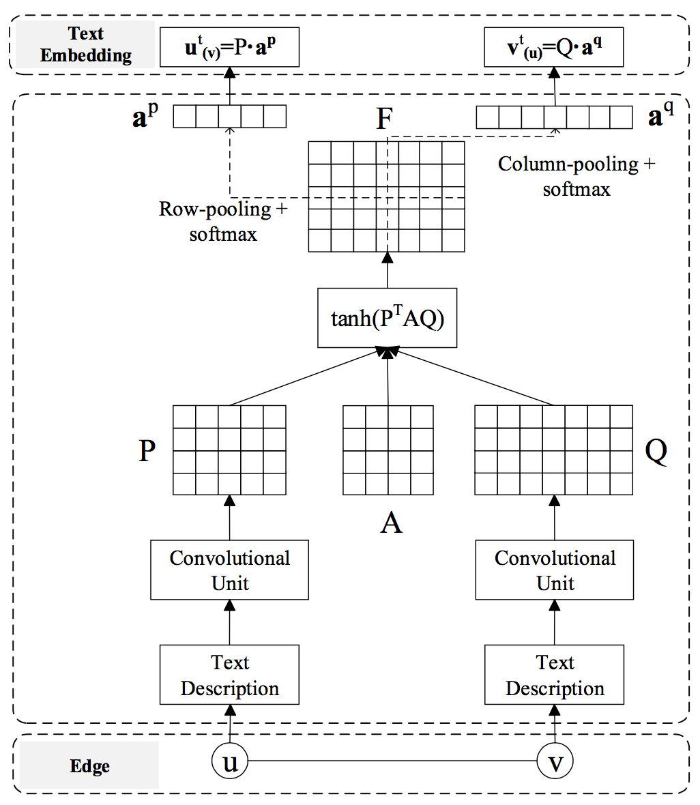
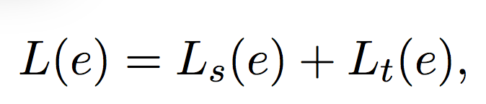
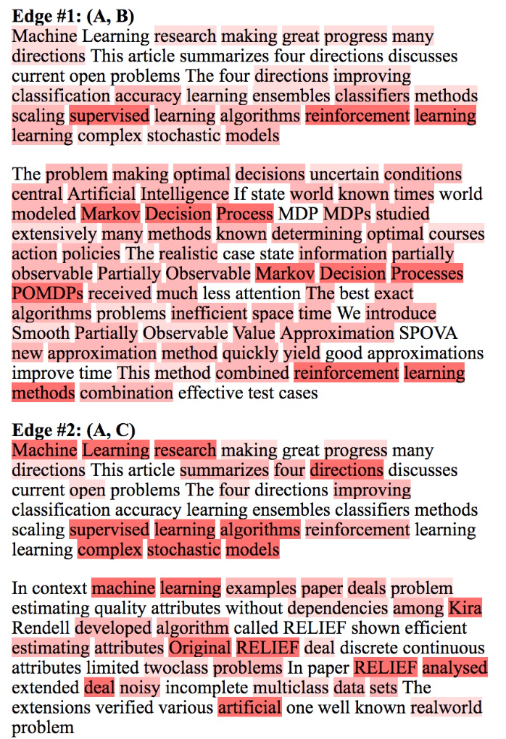
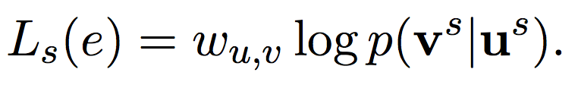
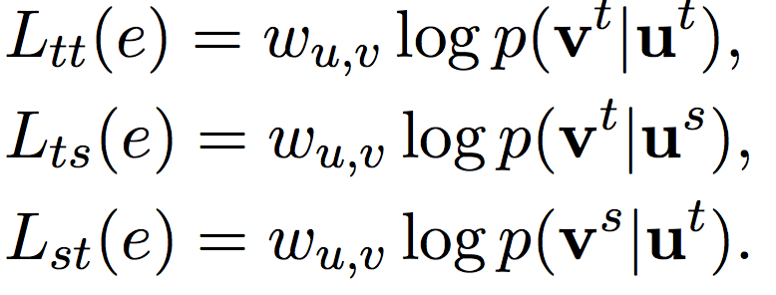


CANE: Context-Aware Network Embedding for Relation Modeling
Cunchao Tu^{1*}, Han Liu^{2*}, Zhiyuan Liu¹, Maosong Sun¹
¹Tsinghua University ²Northeastern University, China
Introduction
Experiments
Network embedding (NE)
  plays a critical role in network analysis.
  represents vertices with efficient low-dimensional embedding vectors.
Existing NE models
  aim to learn a fixed context-free embedding for each vertex.
  neglect the diverse roles when interacting with other vertices.
CANE: Context-Aware Network Embedding
  assumes that one vertex usually shows different aspects when interacting with different neighbor vertices.
  learns context-aware embeddings for vertices with mutual attention mechanism and is expected to model the semantic relationships between vertices more precisely.
Link prediction (AUC) on Cora, HepTh and Zhihu
Vertex classification (Context-aware to context-free)
Method
For each edge e=(u, v), CANE aims to maximize
Structure-based
Text-based
Structure embedding + Context-aware text embedding
Case study
  Select three connected vertices in Cora
  Paper B and C concern about different parts of A
  These key elements give an exact explanation on the citation relations
Paper and code:
Email: tucunchao@gmail.com
Homepage: http://thunlp.org/~tcc

